Slide 1
Power Saver Servant
Vihang Gosavi 09005016
Ashish Yadav 09005018
TEAM - IV

Slide 2
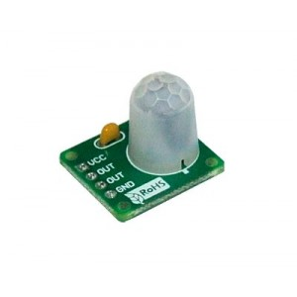
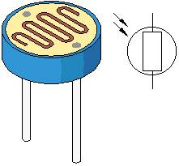
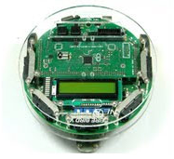

What is Power Saver Servant?
An automated robot which roams around your house.
Smartly detects if there is any kind of wastage of electricity.
Turns all unnecessarily “ON” devices “OFF”.
Alerts the User about this wastage.
+
+
+

Slide 3
Tasks:
Make robot maneuver swiftly and smoothly in house.
Make the sensor circuits and calibrate them to interpret environmental conditions appropriately.
Building the Smart-switch, Hardware as well as software.
Setting up wireless communication between the robot and Smart-switch.
Creating communication Interface between robot and User using Android Phones.

Slide 4
Project Plan:
Building and calibrating the sensors.
Smoothening robot’s movements.
Combining above two for first prototype.
Building Smart-switch – Hardware.
Programming of smart switch.
Communication between smart-switch
and the robot.
Using the robot to actually control AC
devices
Syncing all the modules to completely implement the Power Saver Servant.
Ready before
First prototype
(~2 weeks)
2nd Stage
(~1 week)
FINAL DEMO
(~1 weeks)

Slide 5
Work Flow Diagram - I
Interaction of Power Saver Servant with environment.
POWER SUPPLY
Relay
SMART
SOCKET
Electronic Device
Relay
X-bee
Environment
Wi-Fi
PSS BOT
Wi-Fi module
X-bee
Sensors
Light
Motion

Slide 6
Work Flow Diagram - II
Robot’s decision making & movements.
Enter Room
Motion?
No
Switch “OFF”
All “ON” gadgets
Yes
Light?
No
Yes
Go to
Next-Room
Alert User

Slide 7
Innovation & Challenges:
Accurate sensing of the environment.
Tackling externalities, or any other type of outside interference.
Building the Smart-Switch to actually control Live AC devices.
Wireless communication between sockets and the bot.
Abstract and modular implementation.

Slide 8
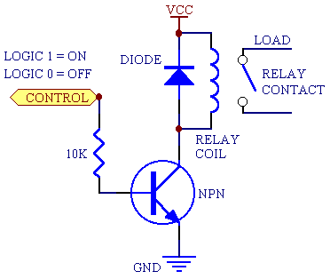
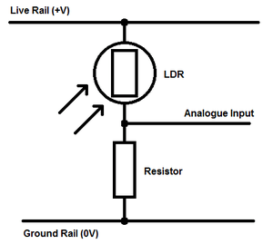
Sensor Diagrams:
Light Detection Circuit
Relay Circuit for Smart Switch

Slide 9
Completing Tasks:
√ Make robot maneuver swiftly and smoothly in house.
- Using Advanced white-line following techniques.
√ Make the sensor circuits and calibrate them to interpret environmental conditions appropriately.
- Numerous Experiments.

Slide 10
Completing Tasks:(ctd.)
√ Building the Smart-switch, Hardware as well as software.
- The real core of our project.
- Using µC and X-bee of Spark V.
- Using relay circuits to control AC devices.
√ Setting up wireless communication between the robot and Smart-switch.
- Defining unique protocol per room.
- Configuring X-bee.
× Creating communication Interface between robot and User using Android Phones.

Slide 11
Testing:
Servant’s movements:
Maneuvering the robot swiftly as well as accurately is tough task.
Speed v/s Accuracy trade off.
For higher velocities (> 120) it missed the turns, went of the grids.
At lower velocities (< 80) it didn’t miss turnings , but movement was too slow to be practical.
So varying speeds at every particular state to provide optimum maneuvering without risking the robot failure.

Slide 12

Testing Arena:
Room2
Room1
Room3

Slide 13
Testing: (ctd.)
Threshold Estimation for sensor:
Accurate motion detection:
After entering any room, robot needs to be stable before it takes readings.
Introduction of delay after stopping in a particular room and before taking sensor readings.
This introduced delay must be greater than time delay of motion sensor.
Delay measured using program
Comes around 1-2 seconds average.
Modular Testing:
Each module Tested separately , then merged.

Slide 14
Re-Usability:
Modulated & well commented code.
Different modules for - Sensors
- Motion
- Power Saving
- Wi-Fi communication
Generic Servant platform:
- Can be adopted for general servant applications.

Slide 15
Future Enhancements:
User communication platform.
-Live interaction with users via GPRS – Android.
Generic servant implementation.
- This robot can be platform to build various servant apps.
- It can come with external hardware modules if any.
e.g. Vigilance robot, Sweeper robot, Waiter robot.
A commercial product.

Slide 16
Thank You!
Questions?

